Slide 1
BITS Pilani
Dr.Aruna Malapati
Asst Professor
Department of CSIS

Slide 2
Statistical Machine Translation

Slide 3
Today’s Agenda
Cross Language IR
Approaches to Machine Translation(MT)
Classification of MT System
Statistical MT – IBM model1 word based MT

Slide 4
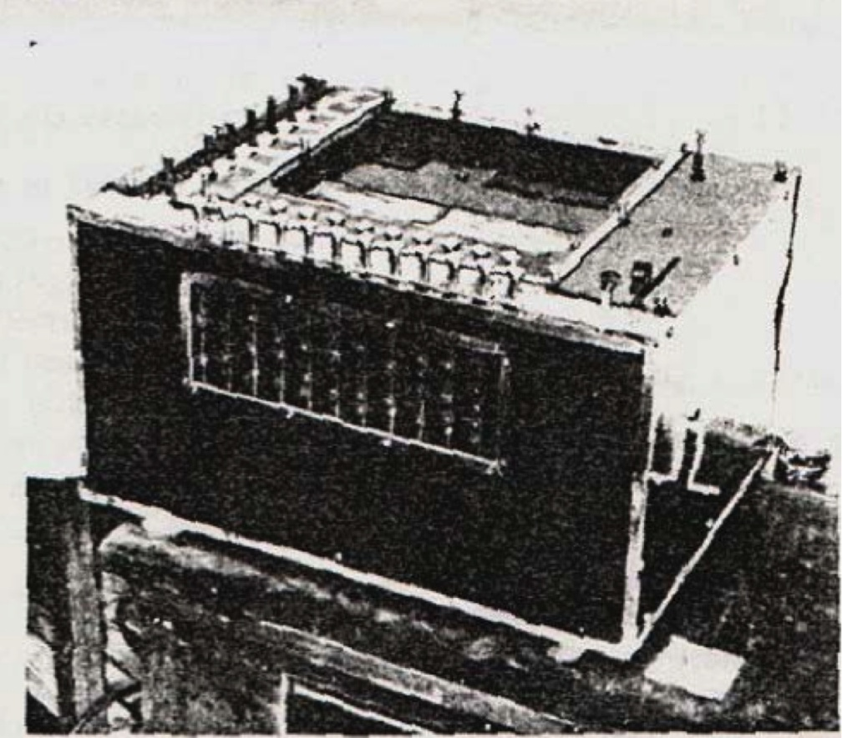

History
COMIT LUTE
METAL KANT
SYSTRAN CANDIDE
TITUS SDL
SPANAM EUROTRA
CUKT UNITRAN
ARIANE REWRITE
GETA PHAROAH
SUSY MOSES
AMPAR HIERO
NERPA SAMT
FRAP IODHUA
LOGOA GOOGLE TRANSLATE
Georges Artrouni's mechanical brain, a translation device patented in France in 1933.

Slide 5
Challenges in MT
Lexical Ambiguity
Example
book the flight -> reservation
read the book -> library
Kill the man -> murder
kill the process

Slide 6
Challenges in MT
2.Differing word ordering
English word ordering: subject verb object
Most Indian languages word ordering : subject object verb
Japanese word ordering: subject object verb
3. Syntactic structure is not preserved
the bottle floated on water
बोतल पानी पर जारी
4. Syntactic ambiguity
john hit the dog with a stick
जॉन एक छड़ी के साथ कुत्ता मारा

Slide 7
Challenges in MT
5.Pronoun resolution
The computer outputs data, it is fast
कंप्यूटर outputs डेटा, यह तेजी से है

Slide 8
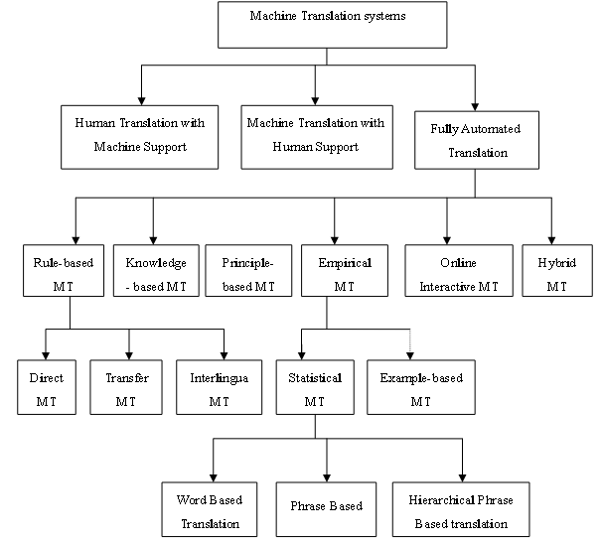
Classification of MT System

Slide 9
Rule-based approaches
Expert system-like rewrite systemsInterlingua methods (analyze and generate)
Lexicons come from humans
Can be very fast, and can accumulate a lot of knowledge over time (e.g. Systran)

Slide 10
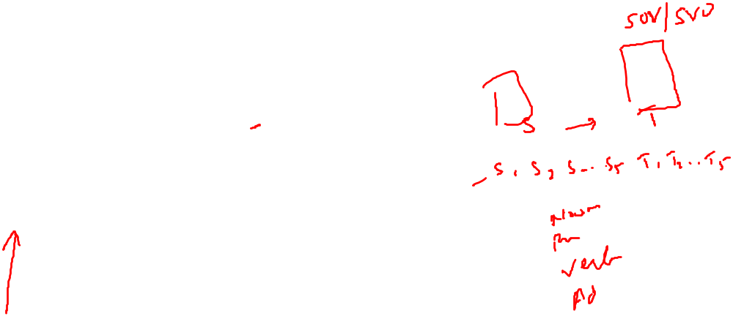
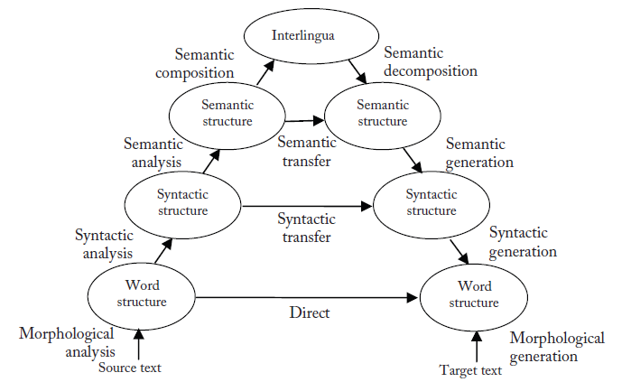
Rule-Based MT
Traditional rule-based MT approaches usually follow what is called Vauquois triangle (Vauquois 1968)
Systran

Slide 11
Statistical MT
Statistical MT relies on translation examples contained in a parallel corpus, i.e., a set of texts translated into another language.
Such a corpus can be further processed into aligned sentences
Word-to-word translation
Phrase-based translation
Syntax-based translation (tree-to-tree, tree-to-string)
Trained on parallel corpora
Usually noisy-channel (at least in spirit)

Slide 12
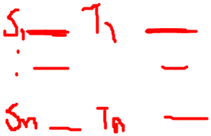
Basic terminology
A bitext is a pair of texts such that one is a translation of the other.
A tritext is a triple of texts such that they are each a translation of the others.
Parallel corpora include bitexts, tritexts, and any set of N texts, such that each is a translation of the others.
Parallel corpora tend towards literal translations(word-for-word translation).
Examples Canadian Hansards, Europarl croups
Notes:
In the field of translation studies a bitext is a merged document composed of both source- and target-language versions of a given text.
Bitexts are generated by a piece of software called an alignment tool, or a bitext tool, which automatically aligns the original and translated versions of the same text. The tool generally matches these two texts sentence by sentence. A collection of bitexts is called a bitext database or a bilingual corpus, and can be consulted with a search tool.

Slide 13
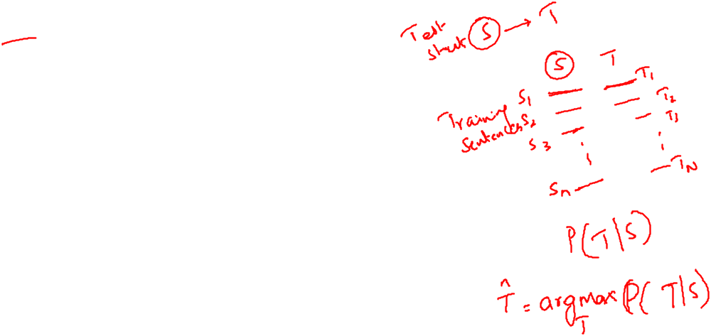
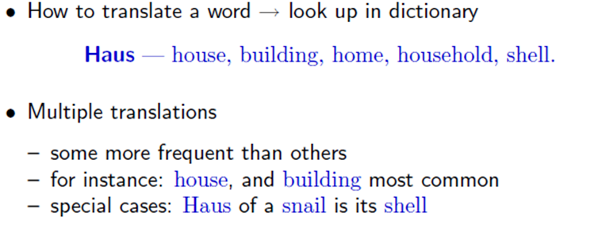
Word-based models
Lexical Translation

Slide 14
Estimating a Probability Distribution
We now want to estimate a lexical translation probability distribution from these counts.
To put it formally, we want to find a function
p_{f} : e → p_{f} (e)
given a foreign word f (here Haus), returns a probability, for each choice of English translation e, that indicates how likely that translation is.
Notes:
The function should return a high value if an English candidate word e is a common translation. It returns a low value if an English candidate word e is a rare translation. It returns 0 if the English translation e is impossible.

Slide 15
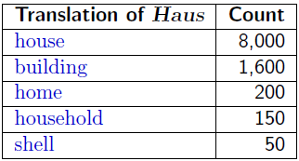

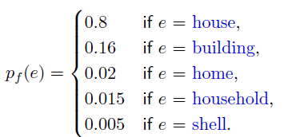
Collect Statistics
Look at a parallel corpus (German text along with English translation)
10,000 occurrences of the word Haus
Estimate Translation Probabilities
Maximum likelihood estimation

Slide 16

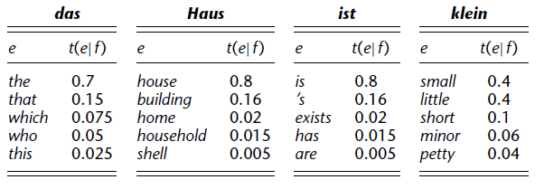

Alignment
Lexical translation probability tables for four German words: das, Haus, ist, klein.
We now denote the probability of translating a foreign word f into an English word e with the conditional probability function t(e| f ), denote this probability distribution as a translation probability.
Given the German sentence das Haus ist klein using the tables we can translate

Slide 17
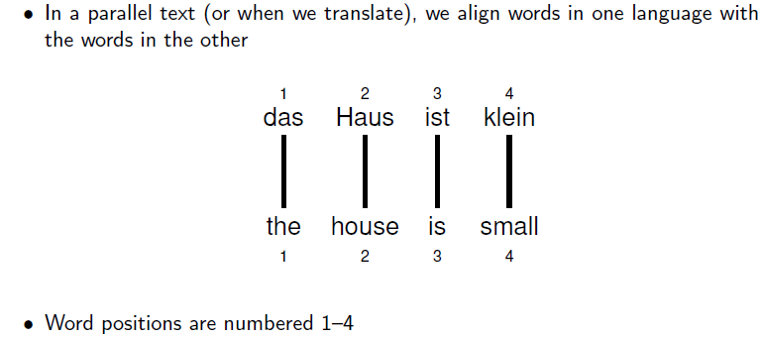
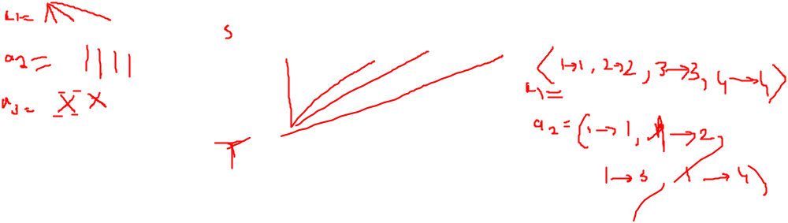
Alignment
Implicit in this translation is an alignment, meaning a mapping from German words to English words.

Slide 18
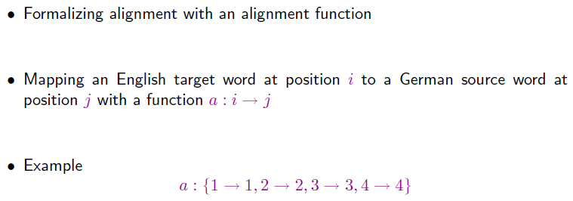
Alignment Function

Slide 19
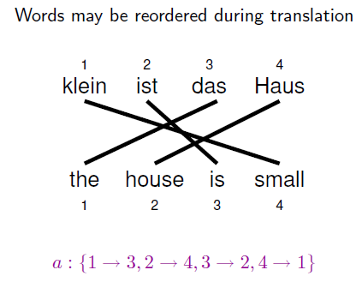
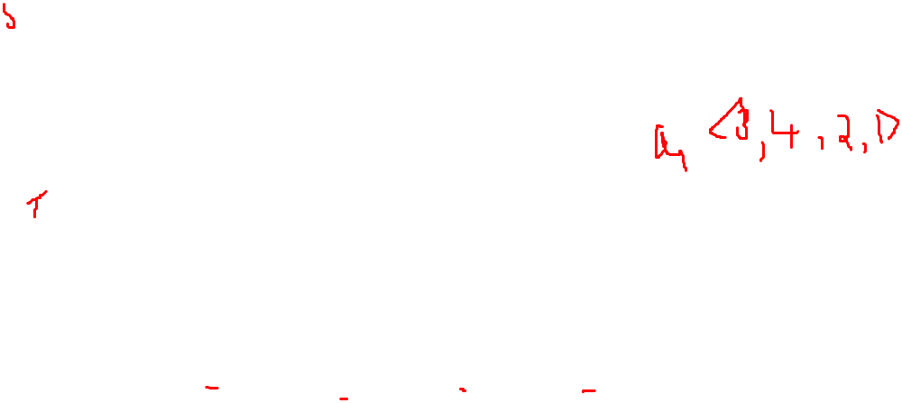
Reordering

Slide 20
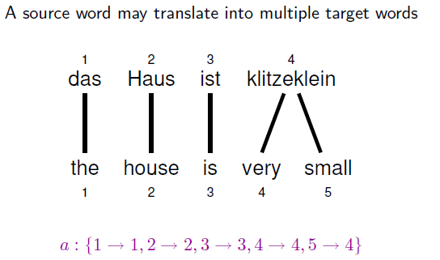
One-to-Many Translation

Slide 21
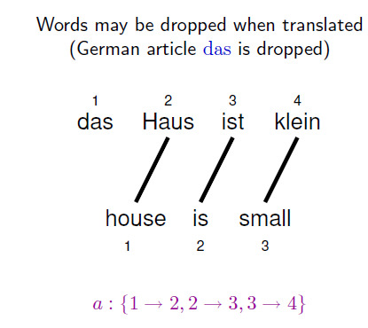
Dropping Words

Slide 22
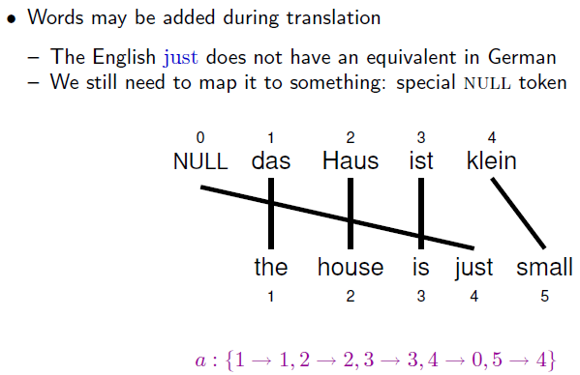
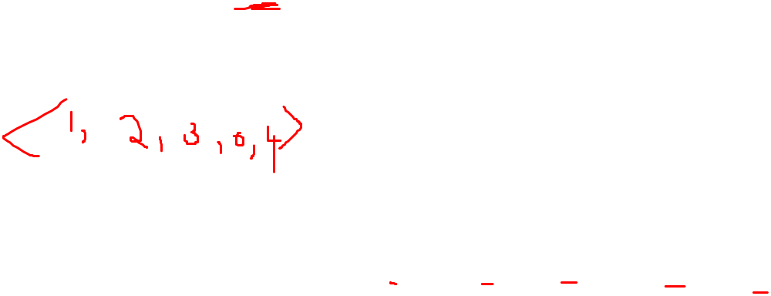
Inserting Words

Slide 23
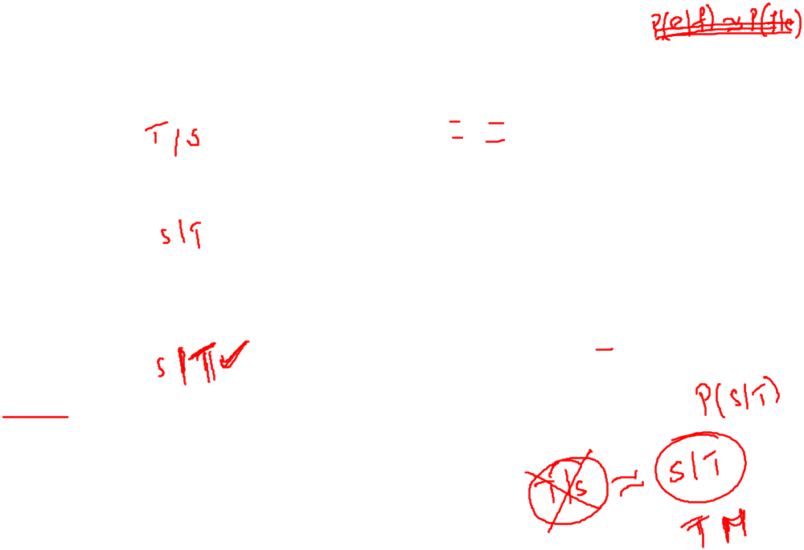
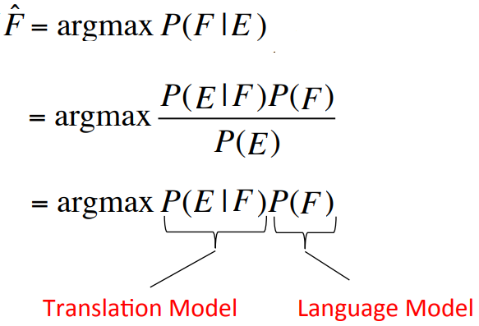
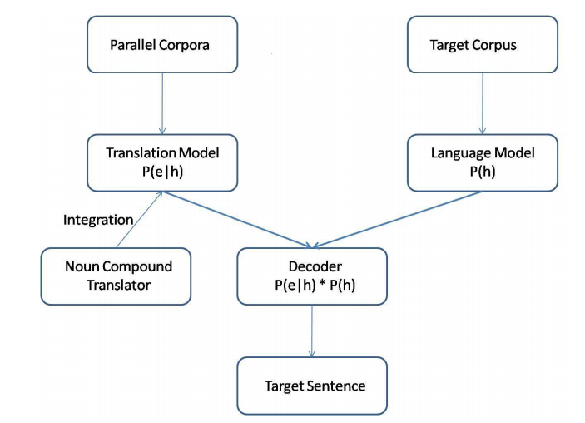

Statistical MT
Given a English sentence E, find a Foreign sentence F.

Slide 24
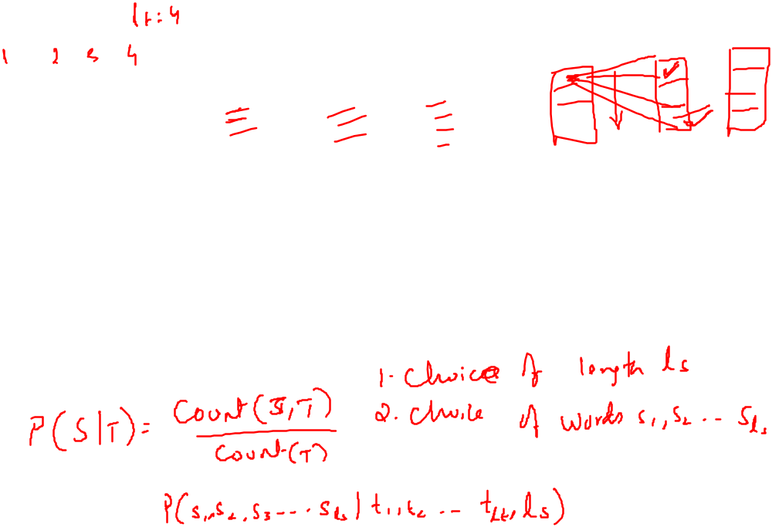
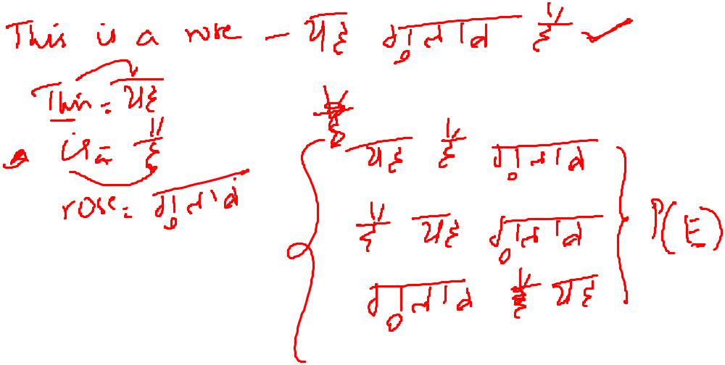

Slide 25
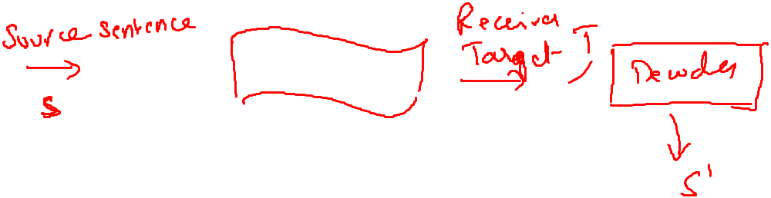
Noisy Channel Model

Slide 26

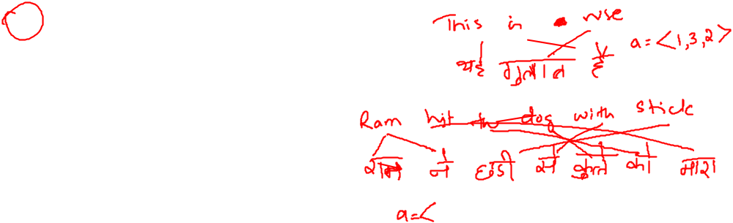

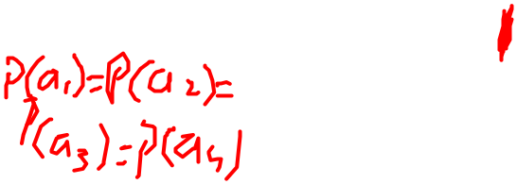
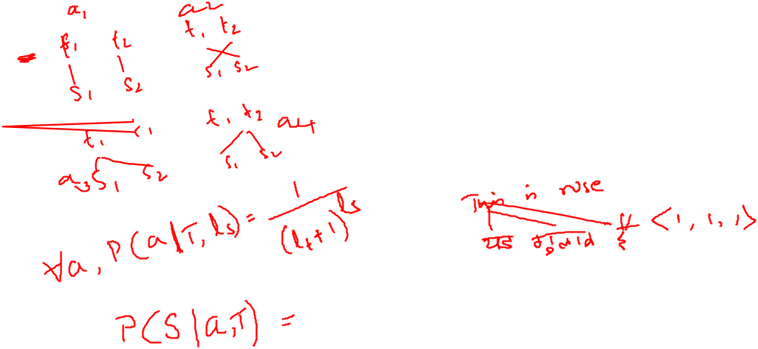
Alignment

Slide 27
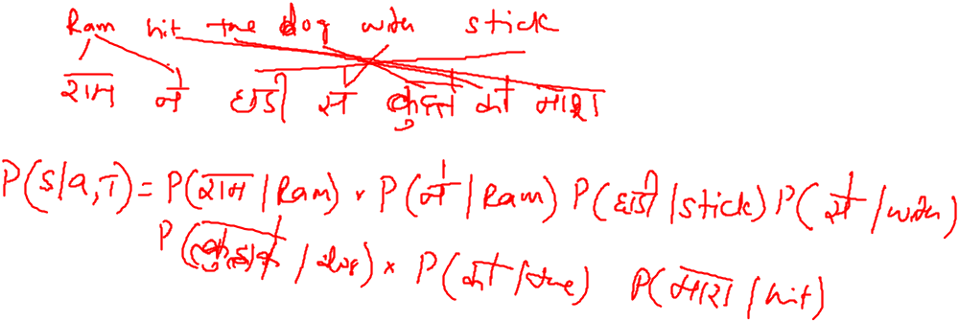
Alignment

Slide 28
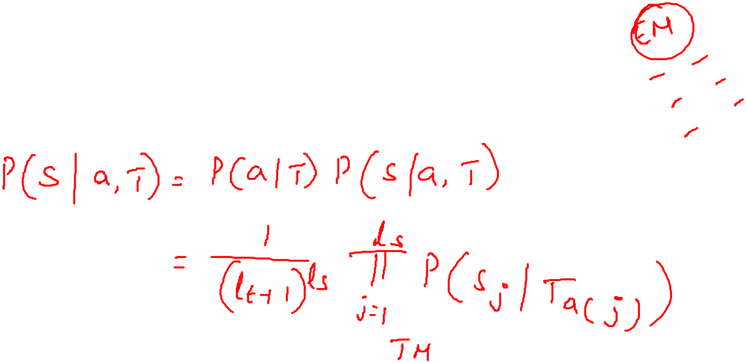
IBM Model-1

Slide 29

The noisy channel model
Generative Direction
P(F)
E: This is my house
F:यह मेरा घर है
In this model we take F and try to map to E
hence our model will be P(E|F)

Slide 30

Three modules of SMT
Language Model(LM): Given F compute P(F)
Good Foreign string → high P(F)
Random word sequence → low P(F)
Translation Model(TM): given(E,F) compute P(E|F)
(E,F) look like translations →high P(E|F)
(E,F) don’t look like translations →low P(E|F)
Decoding algorithm: given LM,TM,E, find F
Find translation F that maximizes P(F) P(E|F)

Slide 31
IBM Model 1
How do we model P(e|f)?
English sentence e has l words e₁,e₂..e_{l}
Foreign sentence f has m words f₁,f₂..f_{m}
An alignment a identifies which English word each foreign word is originated from?
Formally an alignment a is {a₁,,a₂…a_{m}} where each
a_{j} Є {0.. l}
There are (l+1)^{m} possible alignments
Notes:
Let us now turn to IBM Model 1, which is a generative model for sentence translation, based solely on lexical translation probability distributions. For each output word e that is produced by our model from an input word f , we want to factor in the translation probability p(e| f ), and nothing else.

Slide 32
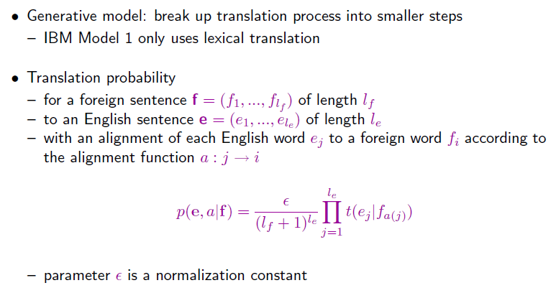
IBM Model 1
Equation 1
so that p(e, a|f) is a proper probability distribution i.e
Notes:
The parameter is a normalization constant, so that p(e, a|f) is a proper probability distribution, meaning that the probabilities of all possible English translations e and alignments a sum up to one

Slide 33
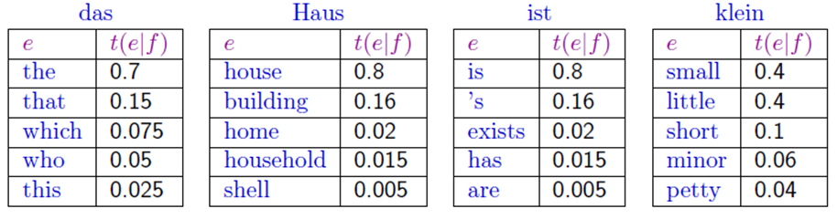
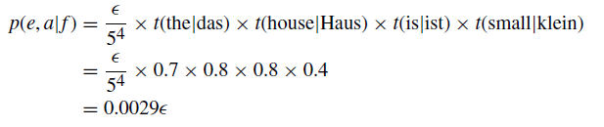
Example
Translation score
if we know the parameters t for this Translation model

Slide 34
Learning Lexical Translation Models
We would like to estimate the lexical translation probabilities t(e|f) from a parallel corpus
... but we do not have the alignments
Chicken and egg problem
  if we had the alignments,
    we could estimate the parameters of our generative model
  if we had the parameters,
    we could estimate the alignments

Slide 35
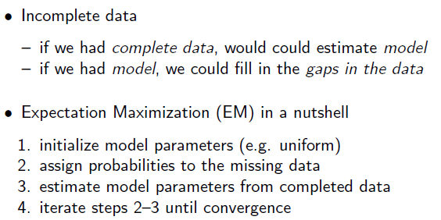
EM Algorithm
Given the parameters compute your expectation over what you think the missing data
Should be (in this case it is alignments)
Given the alignments and missing data compute the model parameters given the complete data

Slide 36
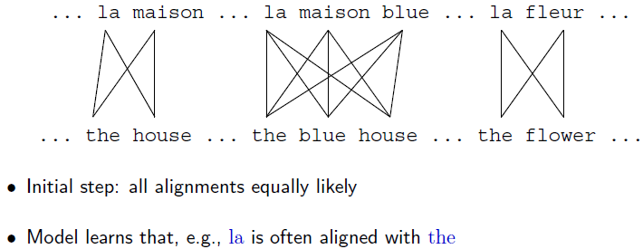
EM Algorithm
In this case we are figuring out alignments
Learn translation parameters given those alignments
After one iteration we learn that the probability of getting the word the given la is higher
So that changes our idea as to what our alignment must be

Slide 37
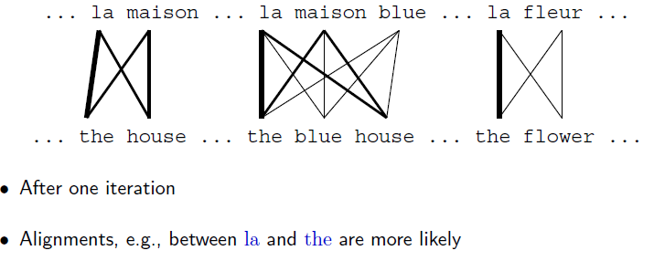
EM Algorithm
The expected number of alignments where the aligned to la is going to be higher
Given the alignment the - la the other alignment positions more compatible

Slide 38
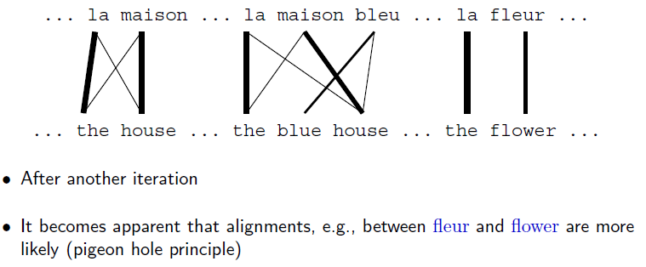
EM Algorithm

Slide 39
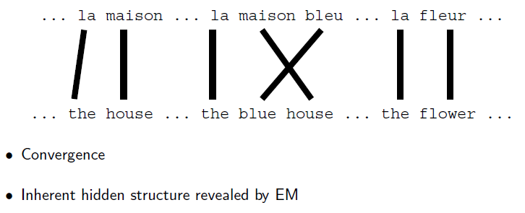
EM Algorithm
Converged answer where we prefer very specifically some words aligned to others words

Slide 40
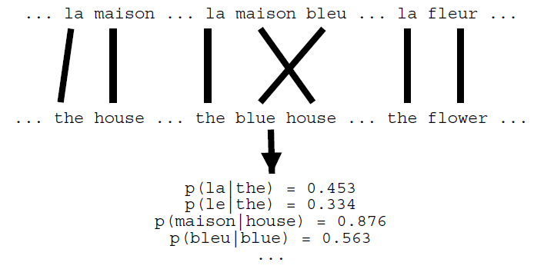
EM Algorithm
Not only alignments we also get good parameter estimation in this case the word
Translation probabilities.

Slide 41
The Problem of Incomplete Data
Estimating lexical translation probability distributions.
We have sentence aligned parallel text not the word alignment.
For each foreign input word f , we do not know which of the words in the English sentence is its translation.
In other words, we lack the alignment function a for this data.
We want to estimate our model from incomplete data.
Notes:
One aspect of our model is hidden from plain view: the alignment between words. For this reason, the alignment is considered a hidden variable in our model.

Slide 42
The Expectation Maximization Algorithm
The expectation maximization algorithm, or EM algorithm, addresses the situation of incomplete data.
The EM algorithm works as follows:
1. Initialize the model, typically with uniform distributions.
2. Apply the model to the data (expectation step).
3. Learn the model from the data (maximization step).
4. Iterate steps 2 and 3 until convergence.

Slide 43
IBM Model 1 and EM
EM Algorithm consists of two steps
Expectation-Step: Apply model to the data
  parts of the model are hidden (here: alignments)
  using the model(given alignments), assign probabilities to possible values
Maximization-Step: Estimate model from data
  take assign values as fact
  collect counts (weighted by probabilities)
  estimate model from counts
Iterate these steps until convergence
Output:
Alignments
Notes:
Learning Lexical Translation Models
So far, we have assumed that we already have these translation probability distributions.
We will now describe a method that allows us to learn these translation probabil- learning translation probability distributions from sentence-aligned parallel text (text paired with distributions a translation, sentence-by-sentence). This method is the expectation maximization algorithm.

Slide 44
IBM Model 1 and EM
We need to be able to compute:
Expectation-Step: probability of alignments
Maximization-Step: count collection (Counting up how many times the words get alignment to each other)

Slide 45
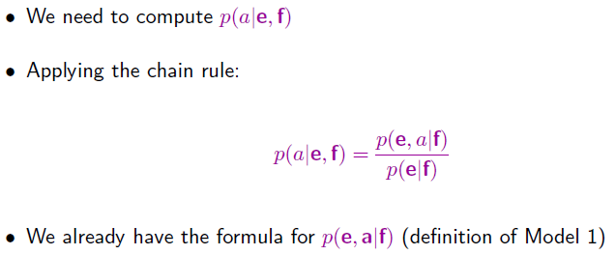
IBM Model 1 and EM: Expectation Step
Compute the probability of an alignment given a complete English Foreign Sentence pair.
In our case we have two events i.e alignment and English sentence generation.
P(a|e) = P(e,a) / P(e) both the numerator and denominator are conditioned on f
P(e,a|f) probability of English sentences and alignment given a foreign sentence
So we need to compute the probability of English string given a foreign string p(e|f)

Slide 46
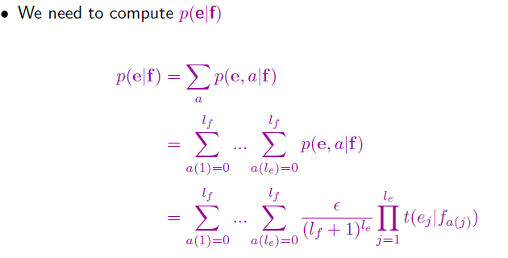
IBM Model 1 and EM: Expectation Step
For every alignment
For every word in e aligned to f
Definition of IBM model -1

Slide 47
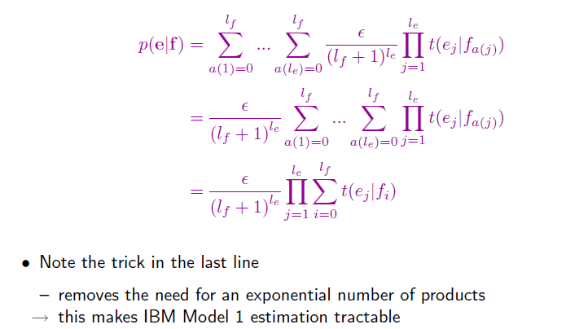
IBM Model 1 and EM: Expectation Step
Probability of an alignment is constant
Messy sums and then a product
Sum over products
Equation 2
products over Sum

Slide 48
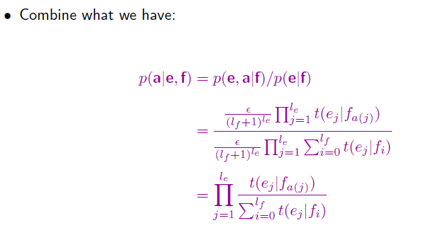
IBM Model 1 and EM: Expectation Step
Substituting the definition of P(e,a|f) from slide 47 Equation 1 and P(e|f) from slide 62 Equation 2

Slide 49
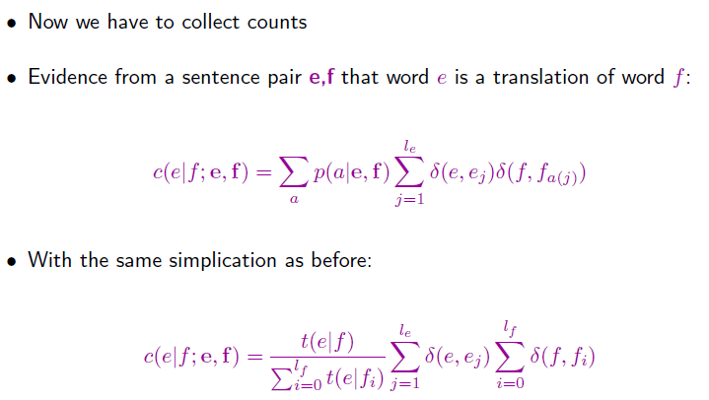
IBM Model 1 and EM: Maximization Step
count where single word in e is translated from the single foreign word f given the
English sentence e and foreign sentence f.
Sum over all possible alignments
number of times e_{j} connects to f_{a(j)}
in alignment a

Slide 50
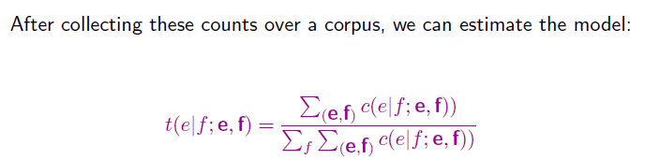
IBM Model 1 and EM: Maximization Step
The probability of translating English word e from foreign word f just summing over
all sentences in the corpus

Slide 51
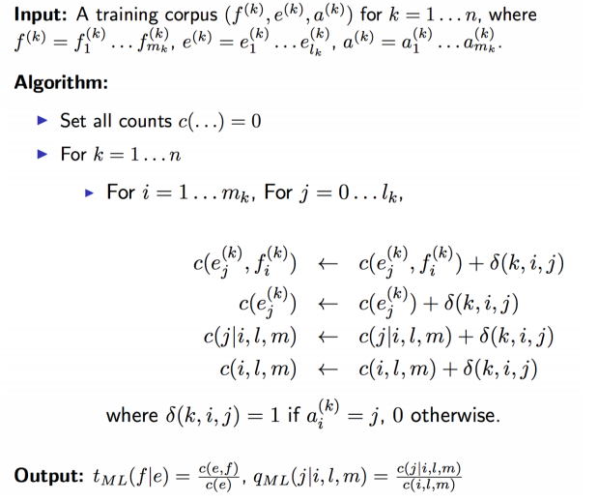

Slide 52
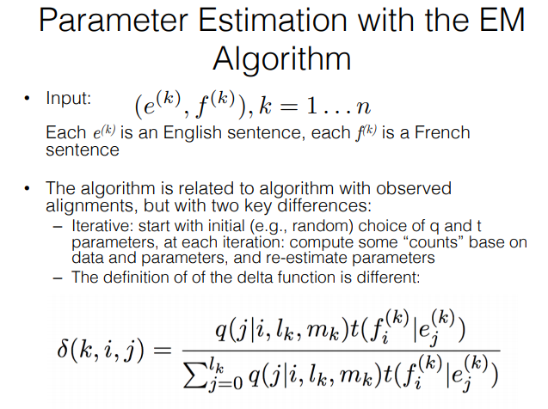

Slide 53
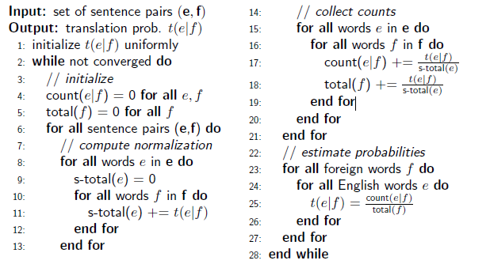
IBM Model 1 and EM: Pseudocode

Slide 54
Take home message
CLIR requires one extra step where either documents have to be translated into query space or viceversa.
In general most common ways for translation are rule based or statistical methods.
IBM Model1 is a statistical word based translation.

